Slide 1
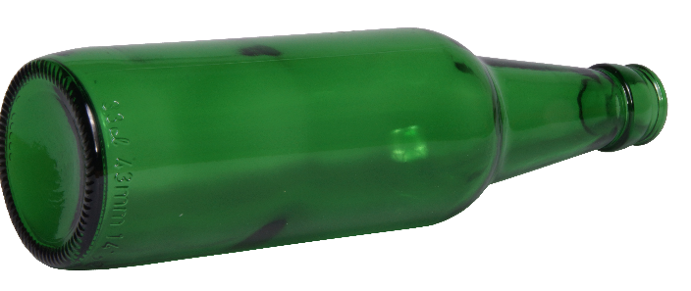
Three tweets to the wind:
Decreasing substance use stigma in 140 characters or less
Ethan G. Lester, B.S., Danielle Moyer, M.S., & Amy R. Murrell, Ph.D.
Notes:
1: How many people have a Twitter, or at least are familiar with Twitter? Twitter is a microblogging service used by many millennials, organizations, etc. In 140 characters or less, people all around the world share their thoughts, feelings, and ideas in real time to a global audience. You can follow accounts you like, retweet (or share) someone else’s tweet, and even passive aggressively (subtweet) someone who is getting on your last nerve.

Slide 2
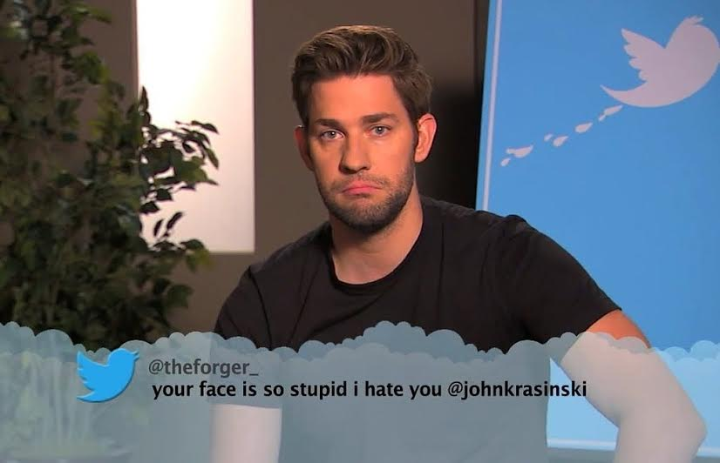
Notes:
This happens to celebrities quite often…

Slide 3
Notes:
and even the president of the united states!

Slide 4
Notes:
Measured in Monthly Active Users (MAU), Twitter measured at over 300 million MAU in 2015, and it has no likelihood of slowing down in the years to come. Twitter has been used to mobilize social revolutions with hashtags like #blacklivesmatter, and has even been attributed to helping strengthen rebel forces and overthrowing dictatorships, Such as in the case of Qaddafi (Gaddafi) in Lybia. Inarguably, Twitter is a powerful and exciting technology that many people are familiar with and use every day. It allows us to take a peek into a person’s immediate context in 140 characters or less. It expands our knowledge of the situation at hand. And it might even be a useful way of providing a pseudo-natural account of human verbal behavior, and can be capitalized on in psychological studies for years to come. We took this mission to heart as we looked at exploring stigma, specifically with regards to substance abuse.

Slide 5
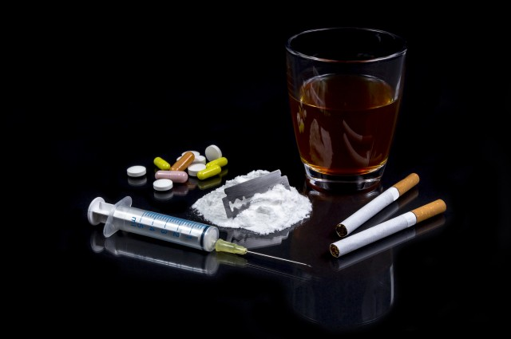
Substance Abuse
We will have stats on this page about the prevalence of substance abuse and the negative effects. I’m thinking:
Physical
Psychological
Interpersonal
Economical
Societal
Allude to stigma
Notes:
Substance use. For a long time, and even in contemporary culture, we have viewed substance use and abuse as a moral issue. Individuals who have these afflictions tend to be viewed as having less personal control, having bad moral character, and being personally responsible for their life choices leading up to their substance using. According to SAMHSAs most current data, over 50 % (approximately 176.6 million persons in the US) of Americans over the age of 12 report being current drinkers of alcohol. Of those people, approximately 17 million meet criteria for an AUD or Alcohol use disorder. Cannabis, now legal in some states (including this one), is the third most used substance after alcohol and tobacco, and recent surveys indicate 4.2 million people ages 12+ meet criteria for an SUD based on their marijuana usage. And yet, we don’t need to venture far to realize that other SUDs are fairly common with stimulants, opiates, and hallucinogens – and these issues are becoming all the more common with the use and abuse of prescription medications (e.g. Adderall and pain pills; All sources above from SAMHSA website). Most are familiar with the toll a problematic substance use can have on an individual’s physical, psychological, emotional, and interpersonal functioning – and some may also be familiar with the economical and societal toll Problematic Substance Use (PSU) have. When paired with moral views of substance use, this can breed a very stigmatizing attitude towards individuals with PSU and SUDs. Equally as harmful are the internalized self-stigma that occurs for the individual (this can effect treatment seeking and outcome).

Slide 6
Stigma
Talk about the effects of stigma and the negative impact it has on peoples’ recovery.
Probably talk about the factors which contribute to stigma and the overall negative outcomes associated with stigma.
Notes:
As mentioned earlier in Teresa’s talk, our lab was especially curious about stigma, and in this case, for substance use. Stigma is defined as a mark of disgrace associated with a particular circumstance, quality, or person. We might be familiar with stigma as being an initial judgement passed which negatively affects our view of an individual, and possibly the view the person has about themselves. These stigmas contribute to social and economic disadvantages for individuals with SUDs, even when these individuals are in recovery (Luoma et al.). Stigma broadly has been documented to occur across a range of mental health issues, and enacted stigma, which is where stigma serves as a means of discrimination toward those with these difficulties, limits basic needs and opportunities like housing, employment, and social support and relationships. In fact, SUDs have been shown to elicit even greater negative social attitudes than schizophrenia (Corrigan et al. 2000, Crisp et al, 2000). Internalizing this stigma (i.e., self-stigma) has been examined by Luoma and colleagues extensively from an ACT conceptualization. Self-stigma can serve as a barrier to an individual’s pursuit of valued behaviors, lower self-efficacy, and even delay or prevent them from seeking treatment for their SUDs. As Luoma and colleagues state in their paper, very few educational and protest-oriented stigma reduction methods are effective (e.g., Smart & Wegner). However, they mention that the strongest evidence for these interventions for recuing stigma comes from creating personal contact between the two parties in a positive context (e.g. link et al 2002). Ah yes, the context… Who would have thought at a CBS conference we would talk about that?

Slide 7
Notes:
A behavior can only be understood in the context within which it occurred (Ramnero & Torneke, 2008).Take Heroin for example. In one temporal context, it was seen as a safe drug to use (and in fact, many opiate derivatives are used in the context of hospitals so they aren’t seen as “bad). Now, the way we understand heroin is much different. Context is any event that modifies the control a stimulus exerts on behavior. In other words, the effect of a stimulus on a behavior changes depending on the context (Dumas, 1989). Context has a strong influence over both overt (actions) and covert (thoughts, feelings, bodily sensations, memories) behaviors. It has long been studied in the CBS community that expanding the context provides more flexible responding.

Slide 8
Fundamental Attribution Error and Context
The fundamental attribution error (FAE; Ross, Greene, & House, 1977) provides one explanation for this discrepancy. The FAE is the propensity for an individual to overly attribute behavior to dispositional characteristics while ignoring potential external causes of behavior. Increasing contextual information may decrease the frequency of committing the FAE (Quattrone, 1982).
Notes:
This, of course, is not an isolated area of psychology and has actually been discussed at length by social psychologists for decades. For example, Ellen Langer, the author of Mindfulness is quoted as saying, “Social Psychologists argue that who we are at any one time depends mostly on the context in which we find ourselves. But who creates the context? The more mindful we are, the more we can create the contexts we are in.” The fundamental attribution error (FAE) is the propensity for an individual to overly attribute behavior to dispositional characteristics while ignoring potential external causes of behavior. This of course can be problematic if the individual is not given all of the “potential external cues” (i.e. context) for the event. This idea has of course been discussed at length in the academic sphere of social psychology, and the applicability to understanding this phenomenon is a cornerstone of many CBTs. Is has been postulated and tested in several paradigms that increasing these external cues (contextual information) may decrease the frequency of committing the FAE (Quattrone, 1982). Importantly for SUDs, increasing the contextual cues may alleviate some of the stigma which heavily accompanies these afflictions, and could in turn affect attributes like self-stigma and increase beneficial outcomes for these individuals.
The question then became; how would our lab study this kind of contextual change in a way which meaningfully demonstrated the reduction of stigma when given more contextual information. Remember that twitter conversation we had earlier? This was our ingenious way of adding context in a format our participants were quite familiar with. As you will recall with Teresa’s talk on mental health and stigma, we used the same methodology to study substance use and stigma. We will not go through all the methods a second time, but we will quickly review those methods from earlier with regards to our study, trying to answer the key question: does providing more contextual information via tweets from the person with substance use behavior lower the chances of committing an FAE and holding stigmatizing ideas about individuals with substance use behavior. This kind of question is directly applicable to the CBS community in the sense that our treatment methodologies capitalize on changing the context. In fact, we agree in solidarity in this community that the only way a behavior can be changed effectively is by changing the context in which it occurs. And it is clinically relevant that the CBS community has means of implementing these results in a meaningful way for individuals via therapy.

Slide 9
Notes:
This sample consisted of undergraduate students (N=483) recruited through an online psychology department participant pool at UNT. Participants were required to be at least 18 years of age, and fluent in English. Students received compensation in the form of extra credit towards a course of their choosing.
The majority of participants were female (74.5%; N = 359) and Caucasian (49.3%; N = 238). The sample was fairly evenly distributed across classification.

Slide 10
Notes:
Here is the racial/ethnic makeup of this sample.

Slide 11
Notes:
And here is the percentage of those who had previously attended therapy. Approximately half of the participants were psychology majors. The measures used for this analysis (which is part of a bigger study) included a demographic questionnaire (gender, ethnicity, school major, classification in school, relationship status, income, parental SES, and psychotherapy attendance).

Slide 12
Measure | Example | Alpha
Intolerance Schema Measure | Poor people are lazy. I welcome new friends who are gay. (R) | .97
Attributional Complexity Scale | Once I have figured out a single cause for a person’s behavior, I don’t usually go any further. | .58
Stigma
I like this person. I think the situation is the person in the story’s fault. I would avoid this person.
Notes:
The Attributional Complexity Scale assesses the complexity of attribution. The current study utilized only the complex vs. simple subscale. This subscale asked participants to choose complex or simple explanations for observed behavior, which maps on well to the FAE. An example item is, "Once I have figured out a single cause for a person’s behavior I don’t usually go any further." The internal consistency for this subscale in this sample was .58. While this alpha is questionable, it is noteworthy that this subscale is only four items and it is common practice to use the individual subscales of the ACS in research. Higher scores on this measure indicate more complex attributional styles.

Slide 13
The student sitting next to you bangs a fist on the desk and groans loudly.
Notes:
So by now you guys are old pros at this! Imagine that. How do you feel about this person? Do you like them? Would you avoid them? (Obviously the feelings in this room are likely skewed by the fact that it’s a room full of ACT psychologists!)

Slide 14
Notes:
Ok, here’s the first tweet. Second tweet. Third tweet. Fourth tweet.

Slide 15
Stigma will decrease over time as increasing contextual information is provided.
*
*
*
*
Linear Trend: Partial Eta Squared = .34, F(1) = 328.41, p < .001
Quadratic Trend: Partial Eta Squared = .39, F(1) = 408.95, p < .001
Notes:
Hypothesis: For the larger study, we expected stigma to generally decrease over time as increasing contextual information was provided. However, in looking at this individual scenario, we wondered if stigma would actually increase when given information about substance abuse. For this analysis, we used a standard repeated measures ANOVA. This is what we found (click so that graph appears).
Overall, stigma decreased over time, F = 294.5, p < .001, partial eta squared = .31
Although both the linear trend and quadratic trend were significant, p < .001, the effect size for the quadratic trend (partial eta squared = .39) was larger than the linear trend (partial eta squared = .34)
In addition to an overall effect, changes were actually significant at each time point; however, the largest difference occurred between baseline and tweet 1.

Slide 16
Stigma will decrease over time w/context, particularly for individuals with a history of mental health
treatment.
Linear Trend: Partial Eta Squared = .01, F(1) = 5.92, p = .015
Quadratic Trend: Partial Eta Squared = .01, F(1) = 3.26, p = .072
Notes:
Hypothesis 2: Consistent with previous research, we expected individuals with a history of mental health treatment to be less stigmatizing overall and to decrease more over time. For this analysis, we used a mixed factor repeated measures ANOVA, with treatment history entered as a dichotomous between subject’s factor. This is what we found (click for graph).
Although the overall interaction for the linear trend was significant (F = 5.92, p = .015), the effect size was very low (partial eta squared = .01), and the interaction for the quadratic trend was not significant (F = 3.26, p = .072), so it does not appear that previous treatment history had a large impact

Slide 17
Stigma will decrease over time w/ context particularly for individuals with a generally tolerant schema.
Linear Trend: Partial Eta Squared = .02, F(1) = 6.3, p = .002
Quadratic Trend: Partial Eta Squared = .07, F(1) = 22.95, p < .001
Notes:
Hypothesis 3: We also expected differences between folks with more or less generally intolerant attitudes. To do this, we created a categorical variable. Those with ISM scores between -1SD and +1SD are considered average, those above 1SD are highly intolerant, and those below -1SD are more tolerant. We then ran a mixed factor repeated measures ANOVA with intolerance as a between subject’s factor. And what we found might surprise you! (Click for graph)
In this case, the interaction for a quadratic trend was significant, F = 22.945, p <.001, partial eta squared = .07. This remains a somewhat low effect size, but if you take a look at the graph, you’ll see what is interesting about this result. For those who were highly intolerant, learning about substance abuse did not substantially increase stigma as it did for average and low intolerance.

Slide 18
Stigma will decrease over time w/ context, particularly for individuals with a more complex attribution
style.
Linear Trend: Partial Eta Squared = .004, F(1, 648) = 2.60, p = .107
Quadratic Trend: Partial Eta Squared = .03, F(1, 648) = 22.03, p < .001
Notes:
Hypothesis 4: We also expected differences between folks with simple versus complex attributional styles. Again, we created a categorical variable with two groups this time splitting from the mean for simple and complex ACS and ran a mixed factor repeated measures ANOVA. (Click for graph 374 simple, 276 complex)
Once again we see a very low interaction effect size for the quadratic and no significant interaction for the linear trend, but it may still be qualitatively interesting to look at the differences between groups.

Slide 19
Notes:
Consistent with previous research, these findings suggest that when individuals are presented with more contextual information, their level of stigma towards that individual tends to go down. However, individuals with a previous history of psychological treatment did not significantly differ from those without psychological treatment history. Still, both of these groups had significant changes in stigma related measures given more context from the tweets over time. In some ways, these findings are positive in that an individual will likely have the same positive response given more context, regardless of whether or not they have had some kind of therapy. Future research may look into the kind of therapy an individual receives and its relationship between stigma reduction. It is possible that certain therapies (such as third wave behavioral therapies) might be more effective in lowering stigma given the focus on context. Also, depending on the level of intolerance (a measure which has overlap with stigma), we had an interesting finding. For those who were highly intolerant, learning about substance abuse did not substantially increase stigma as it did for average and low intolerance. At the same time, these individuals had the highest stigma at the end of the 4th tweet presented. This likely indicates that individuals with higher intolerance have less variation in their stigma levels than the other groups. This limit in variation might make these individuals less affected by context than the other two groups, however it is interesting that these individuals have less stigma when initially presented with substance use related issues. People in this group might also be more stigmatizing towards the item specific content (age, sexual orientation, etc.) and not about substance use. Although there was a small effect size for attributional complexity as a grouping variable, the ending trend was consistent with our hypothesis of more complex attributional ability being related to lower stigmas when presented with the most contextual information.

Slide 20
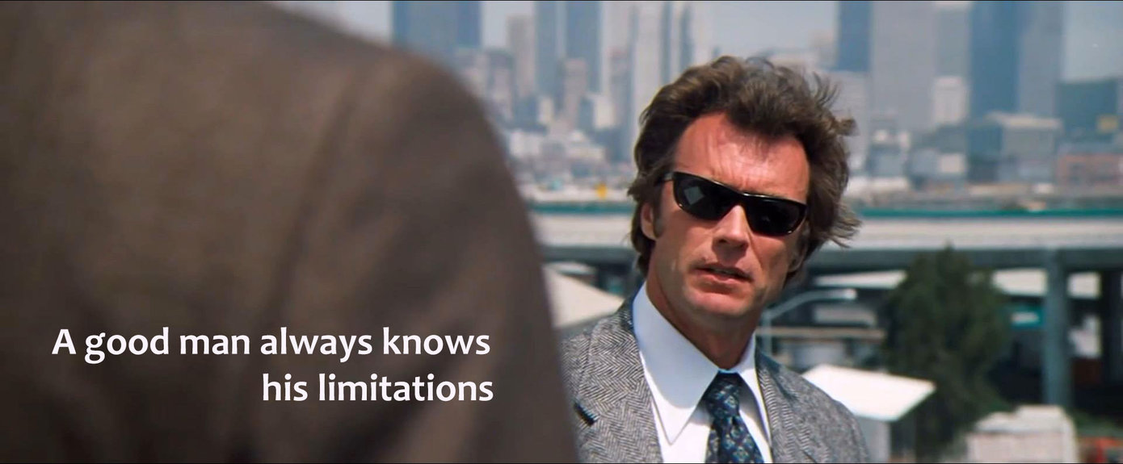
Limitations
Notes:
: In the words of Clint Eastwood in Magnum Force, a man’s got to know his limitations. This study, although adequately powered and well designed, is not without its own limitations. For instance, the stigma measure which we created was a total score of several questions from a larger scale measuring an individual’s impression of another person. As a lab, we decided on the three questions we were using to measure stigma. It might be that if we asked more specific questions about substance abuse stigma, possibly like “how likely would you be to have a drink with this person” or “how would you react if this person asked you for money” we would have had different results. Also, knowing the statistics on problematic substance use and the gender bias (really for externalizing psychopathology), having a considerable amount of females might have also affected the results. The number of psychology majors may have also biased the results if there was some familiarity with the FAE. Future studies might attempt to gather a more even distribution of gender from a variety of majors. Although the data was cleaned and systematically categorized for the ISM and the ACS, categorizing continuous variables can sometimes contribute to a loss in power to detect a significant difference between groups. This is a limitation needed to be considered when analyzing data. Last, we did not ask questions related to the individual’s familiarity with the twitter apparatus. It might have been that some participants who were more familiar with the nature of twitter were more likely to understand the hierarchical nature of the context when the tweets were being presented. Incorporating a measure of understanding may have also been beneficial.

Slide 21
Clinical Implications
Notes:
We see this study as having several clinically applicable findings. For instance, we found that by increasing contextual information over time that an individual is more likely to have decreasing levels of stigma towards individuals with substance use. This finding is consistent with Luoma’s finding that by increasing positive contexts where individuals are interacting with those who have problematic substance use is important for stigma reduction (particularly in their study self-stigma). Also, even though there were differences between categorical grouping variables for tweets over time, the differences and effect sizes were not large. This means that whether or not an individual has attended therapy or has higher attributional complexity (maybe even psychological insight), given the proper intervention with appropriate contextual analysis, an individual will typically have decreasing stigma related attitudes towards individuals with problematic substance use. And, even though our findings also suggested that individuals with higher levels of intolerance tend to have less drastic variation in their level of stigma, their trends were also trending in the right direction towards less stigma. Future research and clinical work can examine and influence what creates large changes for these individuals who initially come in with higher intolerance to affect stigma. On a large scale, we see that the application of this is simple and consistent with decades of research on the FAE. If we can provide people with the appropriate context for issues like substance use, by not making it a moral issue and demonizing them, we will be able to see new attitudes towards individuals with problematic substance use issues.

Slide 22
Future Directions
Notes:
Future directions for this research include the use of familiar mediums for people to respond to ever changing contextual information. Twitter is a platform where people are presented with brief snippets of information which convey powerful messages to a broad audience. If we are able to examine, and possibly change a context for individuals whom are struggling with SUDs in 140 characters or less, there is no telling what our therapeutic interactions which intentionally change the context can do for people (Sappy ending expanded for the W4). Another thing to consider is this – in much of our intervention research, we try and intentionally intervene in some therapeutic way for our participants. In our study, using twitter may have served as a new way of viewing this popular and powerful social media platform – if we got some students thinking about how twitter might work (by using real looking tweets in a format they are used to), some of this study’s effects may have transferred to the student’s everyday life. We can’t at all say with certainty, but we hope that the participant may have taken what they learned in this study about the importance of context and carried that forward responsibly with their social media use. For example, the next time John Krasinski or POTUS gets on twitter and sees a mean tweet about them, they might take a step back, and re-examine the context a bit more.

Slide 23
@UNTContexualPsychologyGroup
Thank you!
Ethan G. Lester, B.S.
#UNT #GoMeanGreen #ACBSWC
A very special thank you to Taylor Lincoln for helping with data collection and the WCP study conceptualization.

